Slide 1
Ways to improve accuracy
By Marie

Slide 2

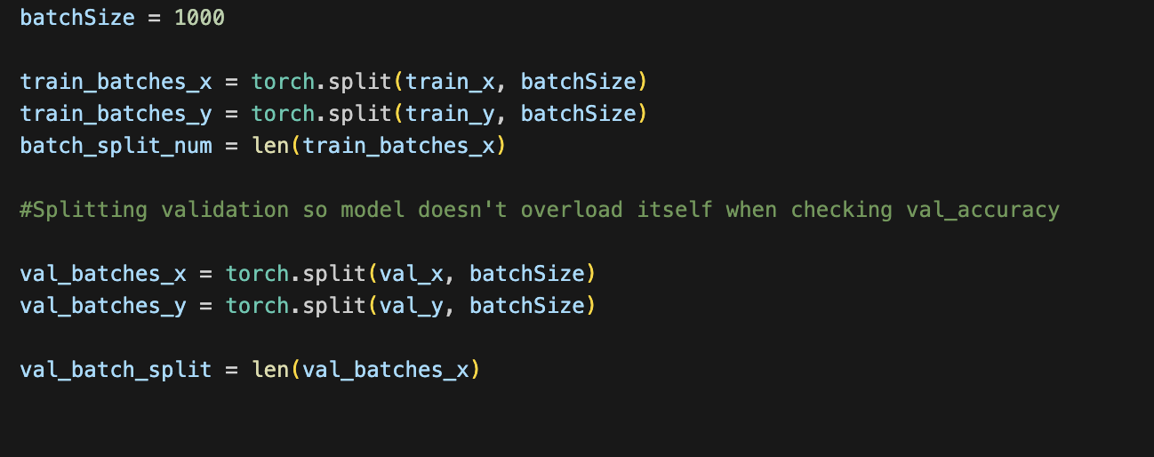
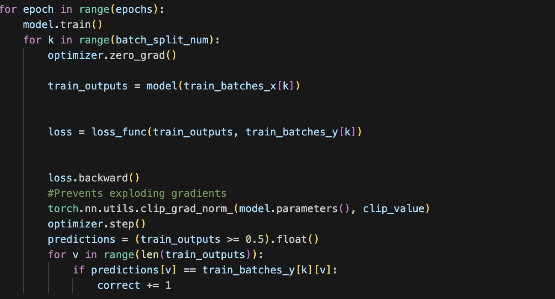
Batch Size:
Training data in batches allows for less computation
Slower training
Sometimes more complexity
Faster convergence

Slide 3
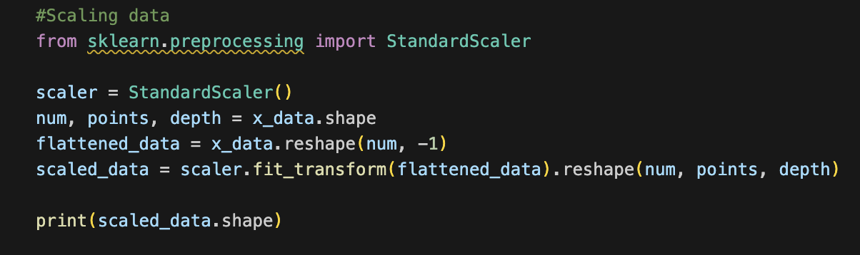
Standard Scaling
Better regularization (less effected by outliers)
All features treated equally
Faster convergence (Sometimes)

Slide 4
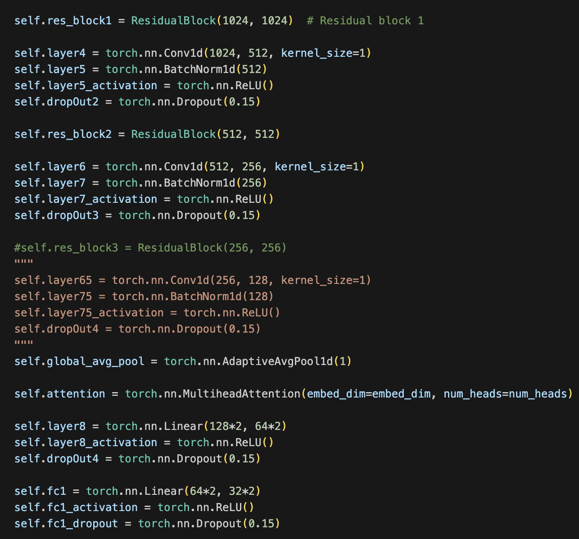
More layers or Less layers ☺
Too many layers can lead to over fitting
Too little layers can lead to underfitting
Same with neurons
Try changing some of the activation functions

Slide 5
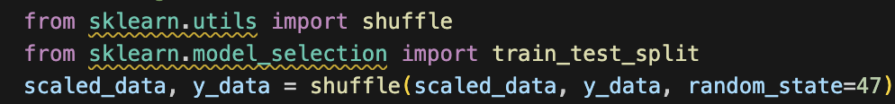
Shuffling Data
Important when you stack data sets on top of each other and you don’t want one of the considered features to be where the data is.

Slide 6
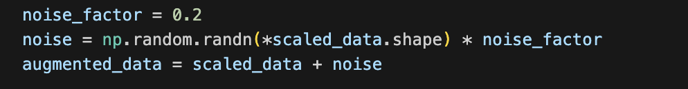
Add noise
- Makes data more general
- Decreases over fitting ⬅ Can lead to underfitting and model is unable to focus on specific features

Slide 7
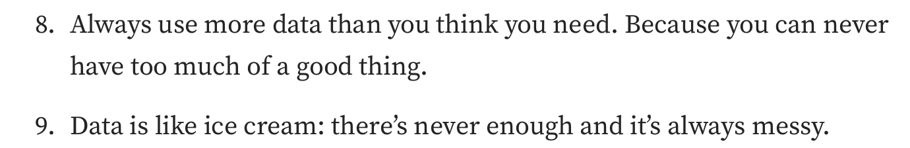
More Data
This one should be obvious

Slide 8
Change your activation Functions
Try typing out torch.nn.functional. and see what your options are
Do some cursory googling to see if another activation function might be better: tanh
Conversely you are not using RELU and should try that

Slide 9
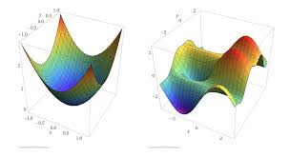
Epochs and Learning Rate
Epochs: Number of times the computer looks at the data.
Learning rate: How much the computer adjusts its weights

